Slide 1
"Analyzing selling price of used cars using Python"
Presented
by
Dhruv Datta(2210990272)
Dhruv Bansal(2210990271)
Garvit Setia(2210990316)
Divanshu Kaushik(2210990290)
Under the supervision
of
Mr. Jatin
Mr. Shubham
Chitkara University Institute of Engineering and Technology
Chitkara University, Punjab

Slide 2
Problem Statement
In this project, we aim to develop an AIML-based system to assist a car dealership company in understanding the factors influencing the selling prices of used cars. Our integrated system combines AIML for natural language understanding and reasoning with Python for data processing and analysis. The system will provide an interactive interface where users can ask questions regarding used car prices, and the AIML component will interpret and respond to these inquiries based on insights derived from the dataset. We will explore a dataset containing various attributes such as car make/model, year of manufacturing, mileage, fuel type, transmission, engine size, number of previous owners, and selling price. Through tasks including data loading, exploration, visualization, feature engineering, correlation analysis, outlier detection, and data preprocessing, we aim to extract meaningful insights into the determinants of used car prices. Additionally, we will utilize AIML responses to generate informative answers to user queries, enhancing the company's decision-making processes and customer interactions.

Slide 3
Solution
To address the task of analyzing the selling prices of used cars for the dealership company, we will first focus on loading and preprocessing the dataset. This involves handling missing values, encoding categorical variables, and scaling numerical features as necessary to ensure data quality. Next, we will conduct exploratory data analysis (EDA) to understand the dataset's structure and uncover patterns. Utilizing visualization techniques such as histograms, scatter plots, and correlation matrices, we will examine the relationships between different variables and their impact on selling prices. Feature engineering will be employed to create new relevant features, such as calculating the age of the car from the manufacturing year. We will then proceed with outlier detection and treatment to address any anomalies that may skew our analysis. Following this, we will select the most significant features through feature selection methods to build a predictive model, if applicable. Additionally, we will integrate AIML for natural language understanding, allowing the system to respond to user queries about used car prices with insights derived from our analysis. This comprehensive approach will enable us to provide actionable recommendations to the dealership company, enhancing their pricing strategy and decision-making processes.

Slide 4
Motivation
The motivation behind analyzing the selling prices of used cars lies in the potential benefits it offers to the dealership company. By gaining insights into the factors influencing used car prices, the company can optimize its pricing strategy, improve sales performance, and enhance customer satisfaction. Understanding the market dynamics, such as the impact of mileage, car age, and other attributes on prices, empowers the company to make informed decisions regarding inventory management, promotions, and negotiations. Furthermore, by integrating AIML for natural language understanding, the company can provide a more engaging and personalized experience for customers, improving communication and fostering trust. Ultimately, by leveraging data-driven insights and innovative technologies, the company can stay competitive in the automotive market and drive sustainable growth..

Slide 5
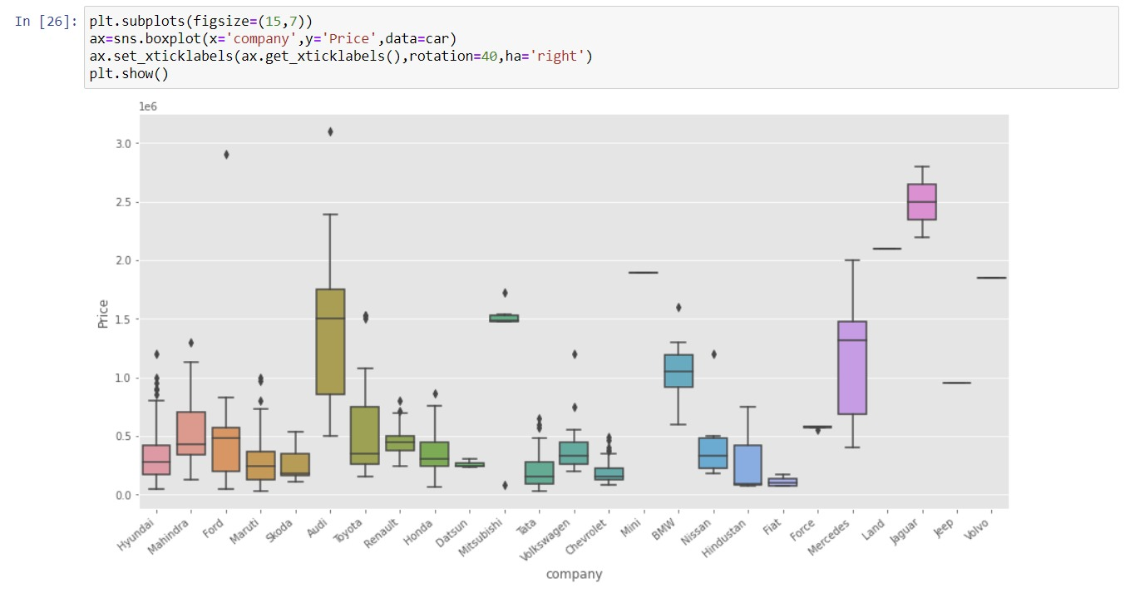
Results

Slide 6
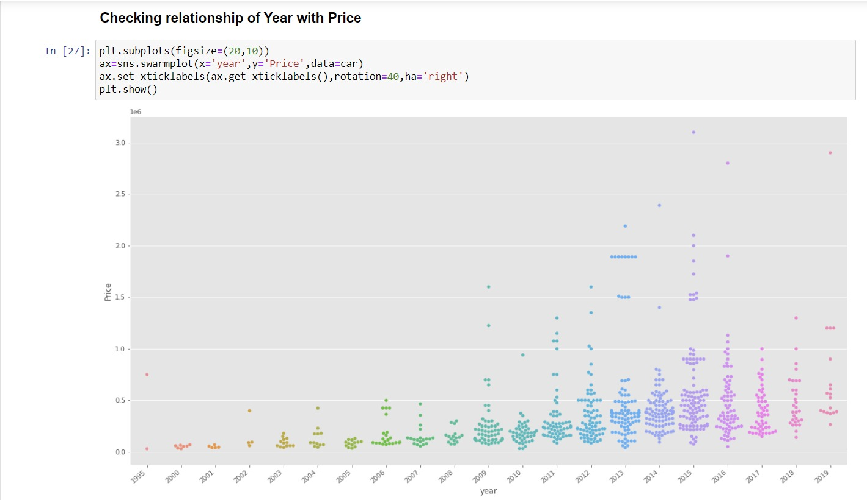
Result

Slide 7
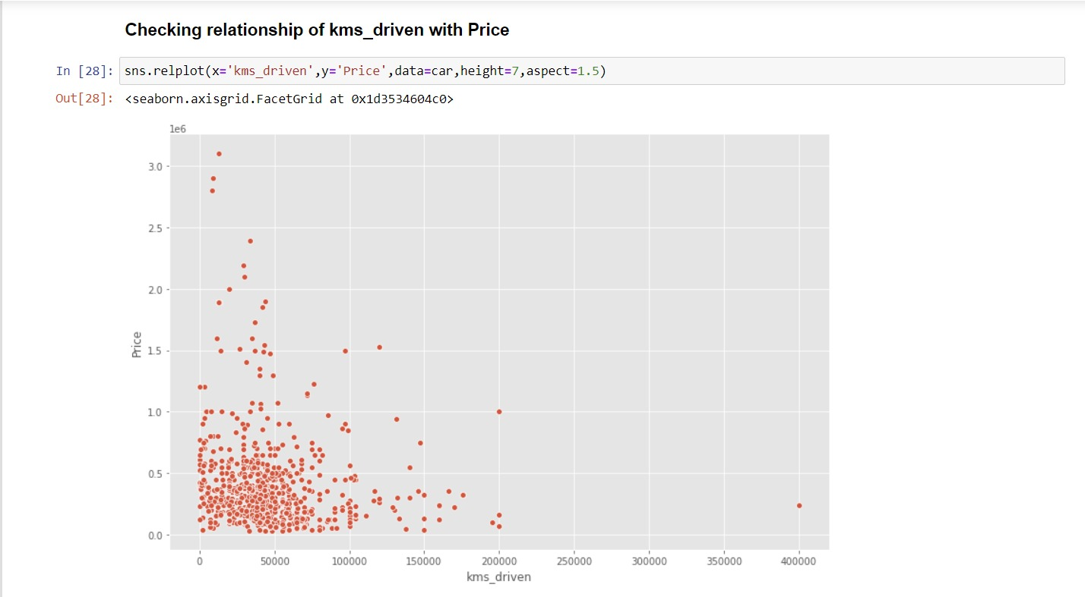
Results

Slide 8
Conclusion
In conclusion, our analysis offers valuable insights into the future trajectory of the automotive industry. Through thorough examination of market trends, consumer preferences, and technological advancements, we have formulated predictions that shed light on what lies ahead.
Our findings indicate a shifting landscape, with electric and autonomous vehicles poised to become increasingly prominent. This transformation is not only driven by environmental concerns but also by advancements in battery technology and the growing demand for connected and autonomous driving experiences. Additionally, we predict continued growth in the adoption of shared mobility services, reflecting changing consumer attitudes towards car ownership.
These predictions carry significant implications for automotive manufacturers, policymakers, investors, and other industry stakeholders.

Slide 9
Theme Plan
Analyzing Selling Price of Used Cars Using Python
Analyzing the selling price of used cars using Python involves a systematic exploration of factors influencing pricing trends in the automotive market. Through data exploration and preprocessing, the dataset is prepared for analysis by addressing missing values, outliers, and categorical variables. Feature selection and engineering help identify key predictors of selling price, such as mileage, age, and condition. Exploratory data analysis unveils insights into the relationships between these features and selling price, facilitating the selection of appropriate machine learning algorithms for modeling. Regression models are trained and evaluated to predict selling prices, with model performance assessed using metrics like RMSE and R-squared. Visualization techniques aid in summarizing findings and communicating insights to stakeholders, informing decision-making processes for used car dealerships and buyers. This analysis not only sheds light on current pricing dynamics but also lays the groundwork for future research aimed at enhancing predictive accuracy and refining pricing strategies in the used car market.

Slide 10
References
Tutorials and Guides:
Numpy: Numpy Part 1 - Introduction to Numpy (youtube.com)
Pandas: Pandas Part 1 - Introduction to Pandas (youtube.com)
Matplot: Fundamentals of Docker & Kubernetes (youtube.com)
Seaborn: What is Data Visualization | Python Seaborn Tutorials (youtube.com)

Slide 11
Questions???
Any Questions
Feel Free to Ask…

Slide 12
Thanks...

